Slide 1

SLIIT students' attitudes and preferences
Regarding
ONLINE SHOPPING
06.01_03

Slide 2
Team Members
Student ID | Student Name
IT23257504 | Weligepola KKHV
IT23265974 | Liyanage DY
IT23268180 | Mahavithana PVD
IT23257436 | Ekanayake EMWS
IT23256446 | Ruhaim MNM

Slide 3
Overview
Introduction
How important is online shopping for university students?
Information Gathering
Data Analysis
Common issues that SLIIT students faced while online shopping
Summary
References

Slide 4

INTRODUCTION
Online shopping is
buying goods or services through websites or apps, often offering convenience and a wide selection but requiring caution to avoid overspending or distraction.

Slide 5

How important is online shopping for university students?
University students often do online shopping for its convenience, wide variety of choices, and ability to compare prices easily. Additionally, busy schedules and limited access to transportation make online shopping a convenient option for them.

Slide 6

Information Gathering
By Google Forms
Anonymous responses from SLIIT students
Interview

Slide 7

DATA
ANALYSIS

Slide 8
Age

Slide 9
Gender

Slide 10
ACademic year

Slide 11
Faculty

Slide 12
Types of products students most prefer

Slide 13
Money Ranges

Slide 14
Most preferred platforms for online shopping

Slide 15
Devices that used for online shopping

Slide 16
Frequency of online shopping

Slide 17
Interest about discount and promotions

Slide 18
Payment Methods

Slide 19
Importance of Online Shopping

Slide 20
Satisfaction of delivery systems

Slide 21
Prefer Online Shopping over Traditional Shopping

Slide 22
Challenges we faced while online shopping

Slide 23
Satisfaction about Security of online shopping

Slide 24
students’ thoughts about future online shopping

Slide 25
Students’ satisfaction about Online Shopping

Slide 26
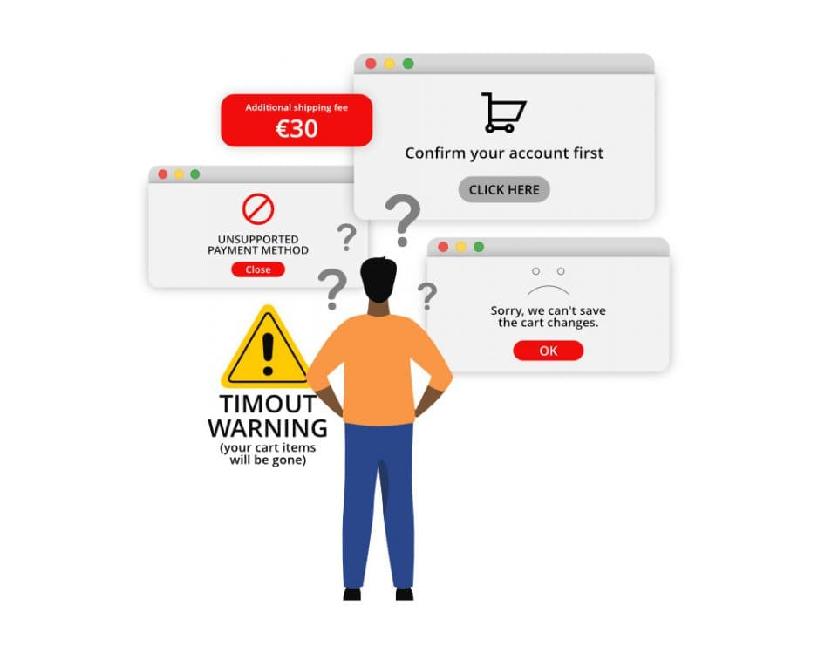
Common issues that SLIIT students faced while online shopping
When I order clothes via online, sometimes the size doesn't match.
Sometimes when we subscribe or pay bills online some websites can borrow our money.
Package not Received.
Took too much time to deliver and kind of worried that I got scammed.
Some goods are not like they are advertised.

Slide 27
SUMMARY
What is Online Shopping?
How important is online shopping for SLIIT students?
How do we online shopping?
SLITT students’ preferences about online shopping.

Slide 28

References
Data collection survey;
Untitled form - Google Forms.
https://docs.google.com/forms/d/e/1FAIpQLSe2QbXu8l60itHMbyFizhmDCPS8k-Cb9kvM4IyEr92dd8N4kg/viewform?usp=sf_link

Slide 29

Any
Question?

Slide 30

Thank You!

